Slide 1


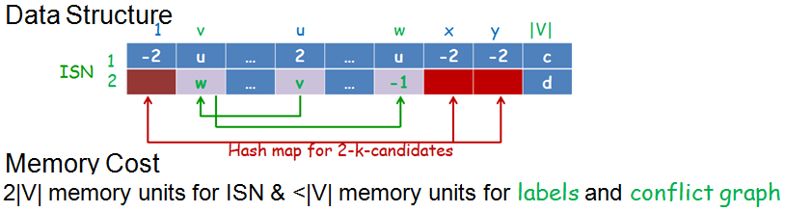
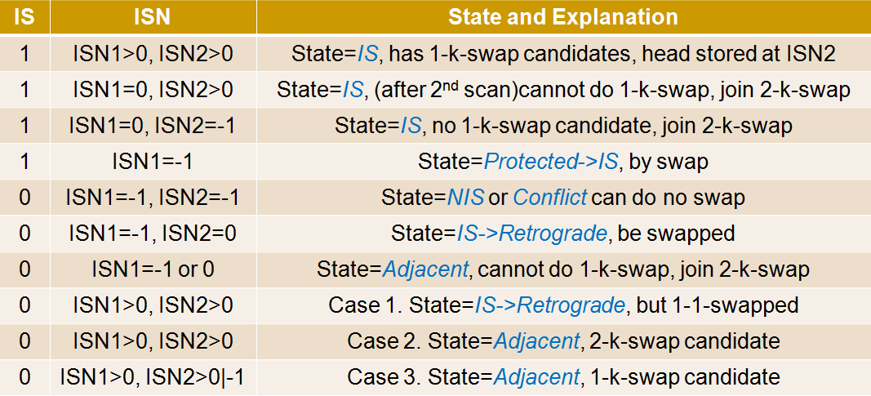
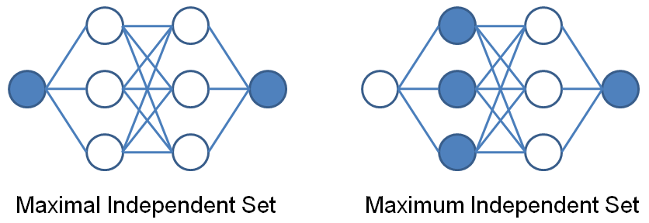
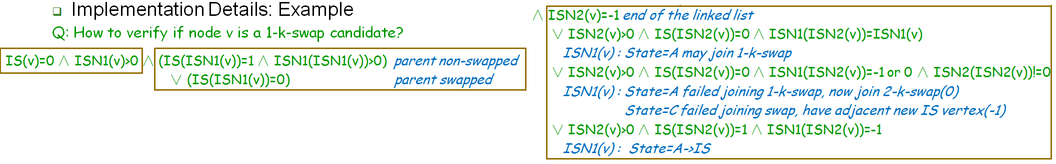
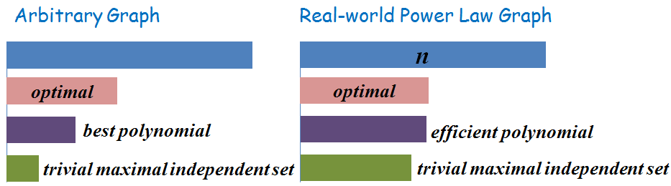
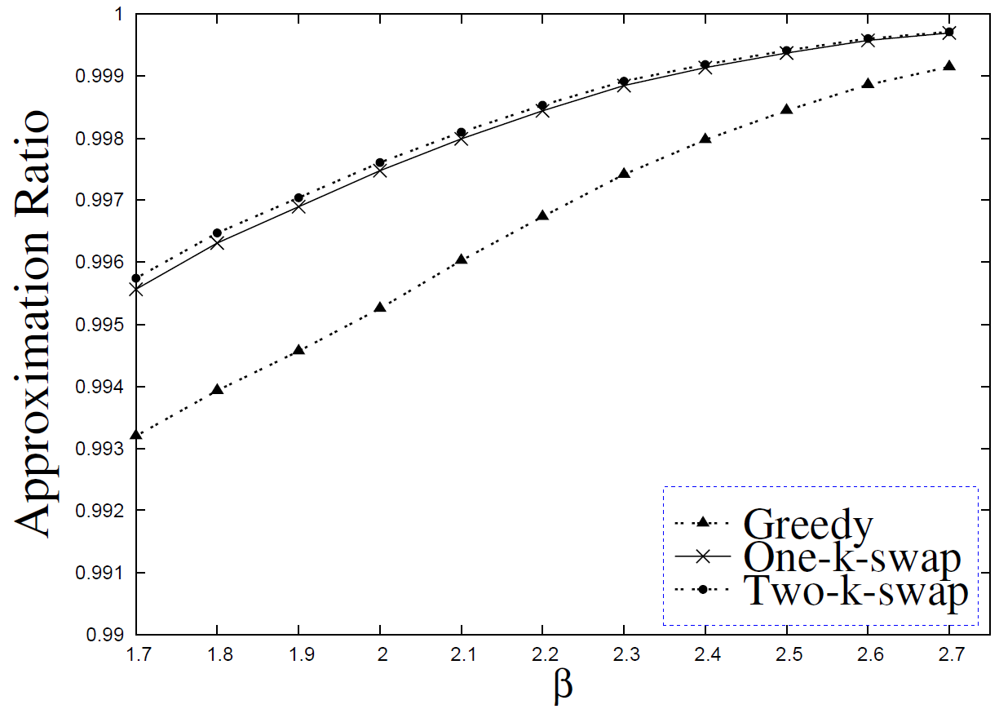
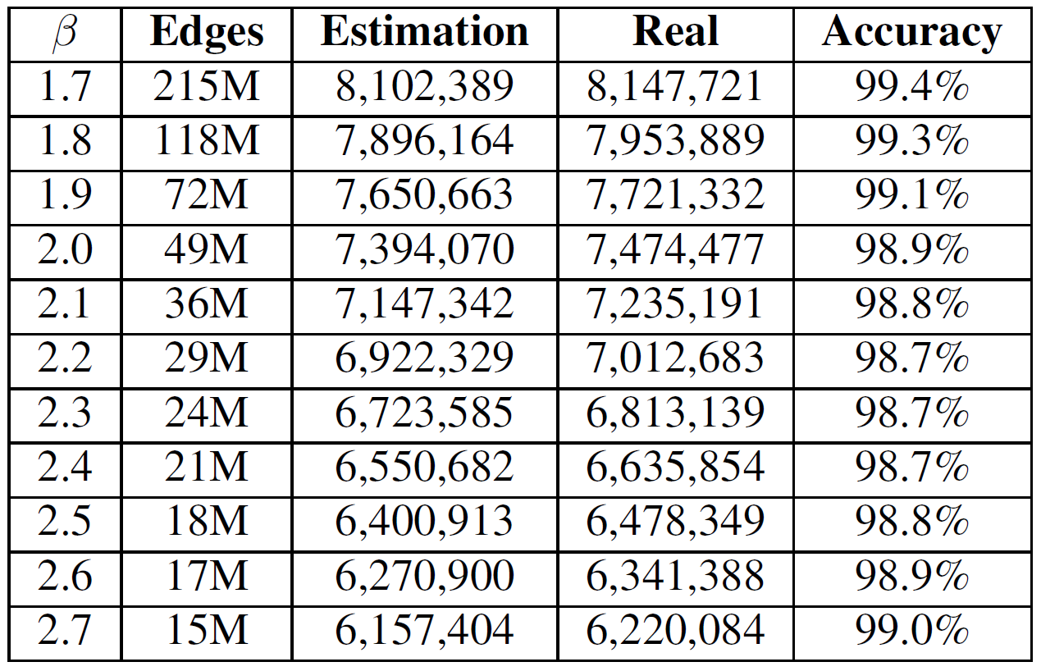
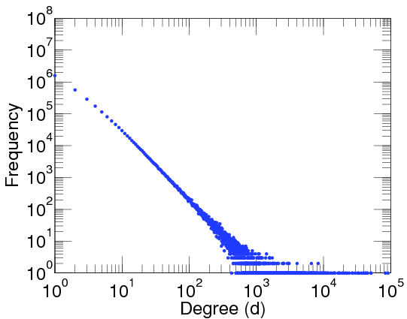
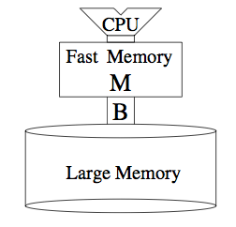
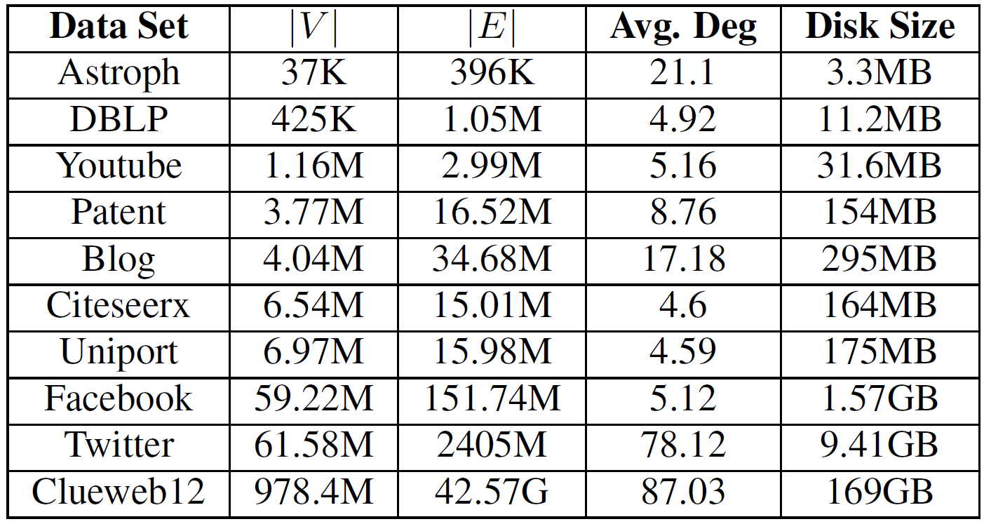
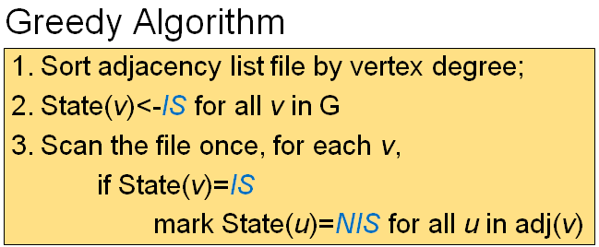
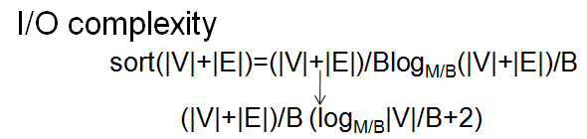
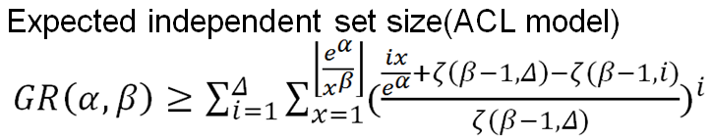
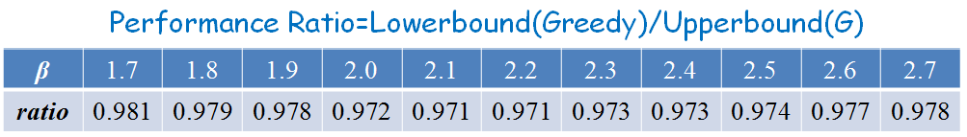
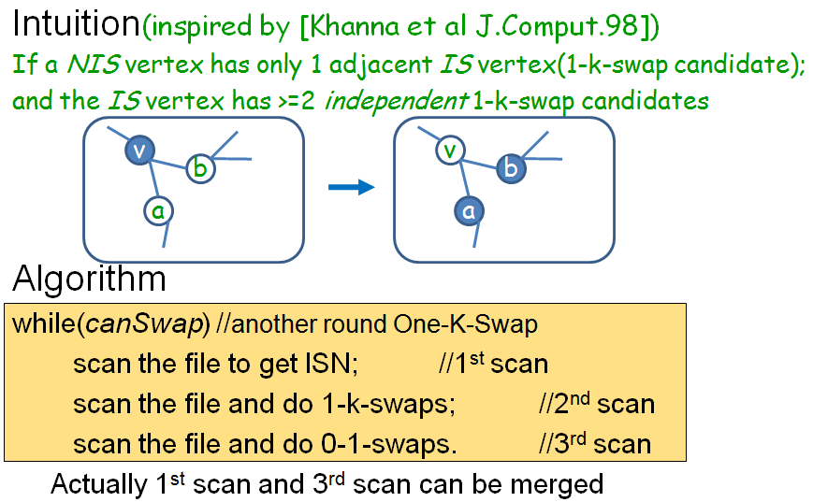
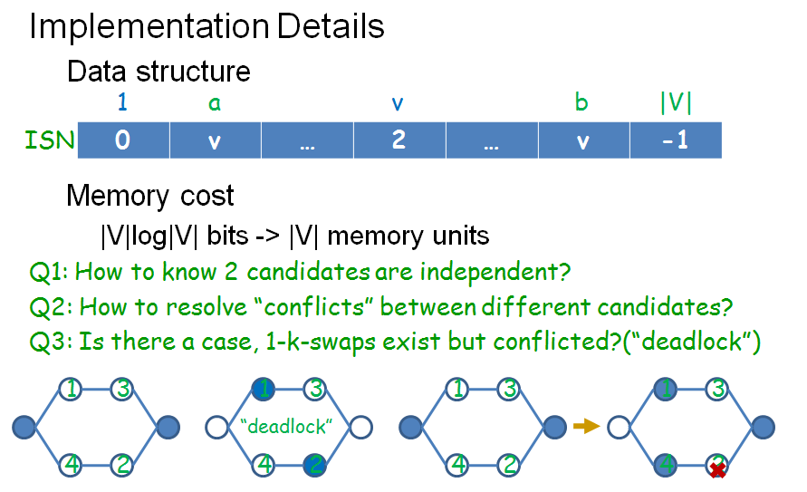
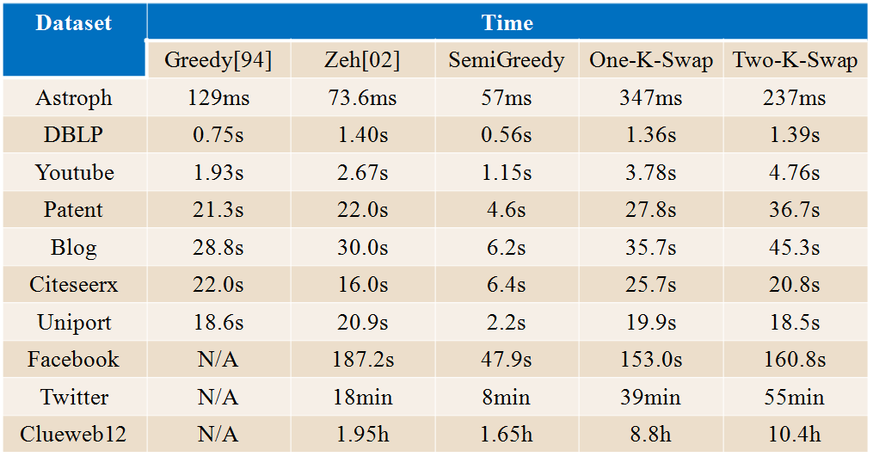
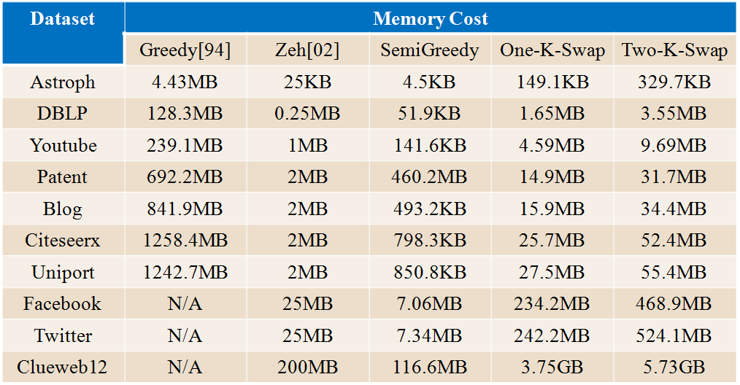
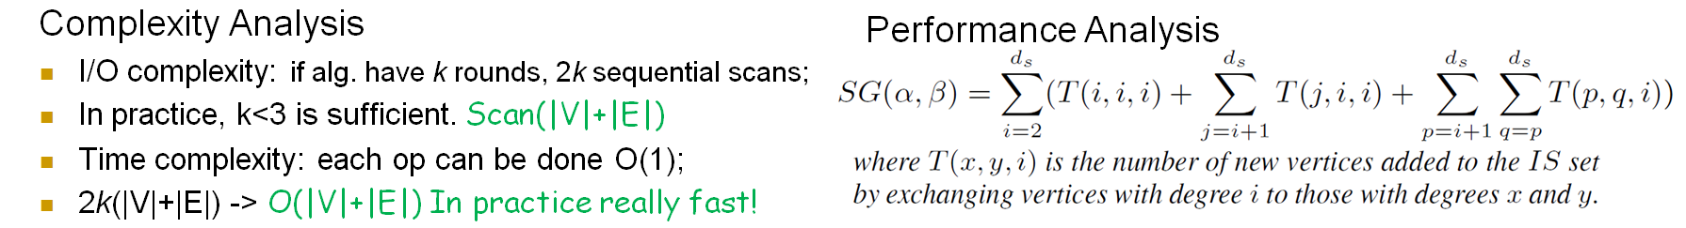
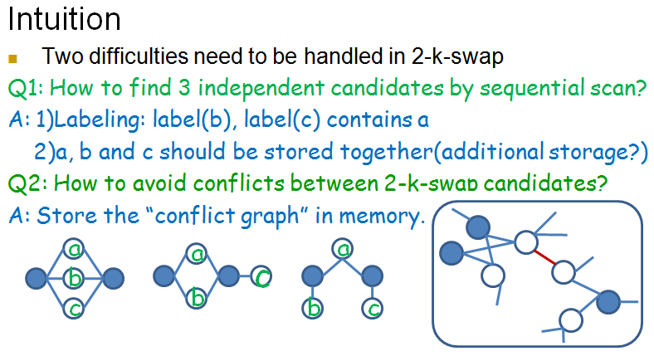
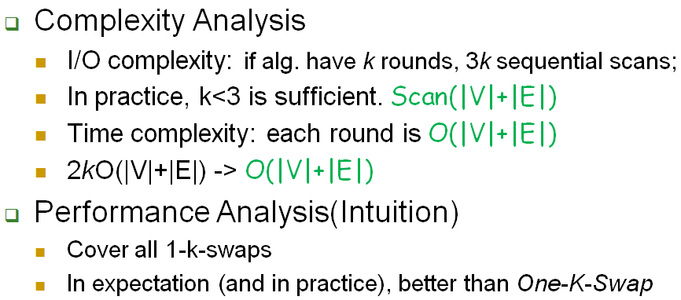
Towards Maximum Independent Sets on Massive Graphs
Yu Liu¹, Jiaheng Lu², Hua Yang¹, Xiaokui Xiao³, Zhewei Wei¹
¹ DEKE, MOE and School of Information, Renmin University of China
² Department of Computer Science, University of Helsinki, Finland
³ School of Computer Engineering, Nanyang Technological University, Singapore
Contact: zhewei@ruc.edu.cn
Motivation and Background
Implementation Details
Hardness of computing maximum independent set: NP-hard and APX-hard.
Existing internal and external memory algorithms either don’t scale well or have no theoretical guarantee.
It’s hopeful to use massive graph properties to make computing a near-optimal independent set much easier in practice.
Experiments and Conclusion
On Synthetic Graphs by ACL Model[Aiello et al STOC00]:
Computation Models and Problem Statement
Real-world Datasets:
Power Law Random Graph Model
-ACL Model[Aiello et al STOC00]
(Semi-)External Memory Model
Our Goals:
-Memory budget: c|V|<=M << |G|
-Low CPU time and I/O complexity
-Find near-optimal independent set
-Have non-trivial theoretical bounds
Memory
Disk
Sampling-based algorithm
Observations
Our greedy algorithm is simple and effective.
One-K-Swap and Two-K-Swap improve independent set size to near-optimal, with limited memory cost and acceptable time cost.
Though Greedy[Halldórsson et al STOC94] also gives near-optimal results for most power law graphs, it cannot scale well on large graphs.
Our algorithms outperform previous external algorithms, both in theory and in practice.
Semi-external Memory Greedy Algorithm
Dataset | Greedy[94] | Zeh[02] | Zeh[02] + One-K-Swap | Zeh[02] + Two-K-Swap | Semi-Greedy | S-Greedy + One-K-Swap | S-Greedy + Two-K-Swap | OPT
Astroph | 17110 | 15275 | 16625 | 16814 | 15019 | 16054 | 16572 | =19106
DBLP | 260992 | 242521 | 260715 | 260961 | 260886 | 261003 | 261007 | =261008
Youtube | 880873 | 823821 | 879078 | 880455 | 878459 | 880642 | 880835 | =880882
Patent | 2073214 | 1711789 | 2018537 | 2047497 | 2032599 | 2070806 | 2078989 | <2320446
Blog | 2116668 | 1855824 | 2094057 | 2109767 | 2096910 | 2117377 | 2121133 | <2216727
Citeseerx | 5750799 | 5307498 | 5719705 | 5737953 | 5731026 | 5747431 | 5749396 | <5765563
Uniprot | 6948528 | 6938348 | 6947851 | 6948149 | 6942879 | 6947397 | 6948048 | <6949108
Facebook | N/A | 18893989 | 57269875 | 57986375 | 58226290 | 58232256 | 58232269 | <58232354
Twitter | N/A | 36072163 | 46978395 | 48059663 | 48121173 | 48742356 | 48742573 | <52335929
ClueWeb12 | N/A | 499444213 | 703485927 | 725810643 | 606465512 | 723673169 | 729594728 | <816673210
One-K-Swap Algorithm
Independent Set Size by Various Algorithms
Time and Memory Cost by Various Algorithms
Conclusions
We develop three semi-external algorithms to find near-optimal independent set on massive graphs, all satisfying
-Low memory cost
-Low time and I/O complexity
-Near-optimal in theory and in practice
-Easy to implement
We give non-trivial theoretical guarantees for our proposed algorithms, which proves to be near-optimal.
Experiments show that our algorithms have better performance and bounds than existing external algorithms.
Two-K-Swap Algorithm

